Slide 1
CORPORATE OVERVIEW
Demand-Driven Supply Chain Planning and Execution

Slide 2
THE ERP PROBLEM
Billions spent on ERP and the needle didn’t move
Manufacturing inventory turns have not improved in 25 years.
$1 Trillion of inventory in US
(Source: US Federal Reserve)

Slide 3
The Core Issue – A critically flawed assumption
MRP based planning in all ERP systems is based on the following logic:
  Based on your forecast - MRP will backward schedule:
    What you need to buy
    What you need to manufacture or assemble
    What you need to package and distribute
    To meet your forecasted demand
What is the flawed assumption?
  THE FORECAST IS ACCURATE!

Slide 4

Less trust in forecast
Forecasting is harder than ever. We want a way to do Tactical Planning using Actual Demand and Recent Consumption. Let’s use forecasts in strategic longer-term planning.
Labor issues hitting hard
I don’t have the staff to handle the amount of items that need attention on a daily basis. I need a way for my small team to clearly see what issues need review. Next gen does not want to use the old tools.
Dynamic re-order points
I have a team that quarterly calculates re-order points that are out of date as soon as we enter them. This process is not automated or scalable and does not react to market demand.
Reduce system noise by planning to dynamic ranges vs. static safety stock
Fire alarms go off every morning for same products because we are managing to a specific number, we want a system that allows us to better identify problems more quickly and intuitively.
Allocate capacity to actual demand
Our traditional MRP system is blind to actual capacity constraints. With our finite capacity planning tool, we fill open capacity early and buy materials for these finished goods and make these items and all too often the world changes.
WHAT WE HEAR
©2022 DEMAND DRIVEN TECHNOLOGIES. ALL RIGHTS RESERVED.
4

Slide 5

THE ERP PROBLEM
Industry Stuck in the Past
Planning in ERP is like flying in Apollo Capsule
Complex and Dated
Operator Dependent
Requires Deep Training and Experience

Slide 6


ABOUT US
Empowering supply chain leaders to achieve tangible and sustainable results with advanced, demand-driven supply chain planning solutions.

Slide 7
ABOUT US
Global leader across the Demand-Driven Enterprise
+ First to market with a suite of demand-driven solutions
+ Demand Driven Institute Affiliate
+ Collaborate with partners to expand market coverage
FOUNDED
CLIENTS
RECOGNITION
2011
ATLANTA
120
IN 8 MAJOR SECTORS
20 STARTUPS TO WATCH
NEW PRODUCT OF THE YEAR
FULLY COMPLIANT ACROSS DDI CERTIFICATIONS

Slide 8
OVER 120 CLIENTS
across multiple industries
2,644,967
4,733,789
1,756
3,597
PARTS
BOMS
LOCATIONS
USERS

Slide 9
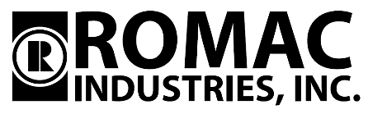
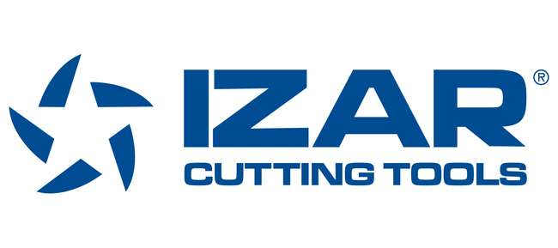













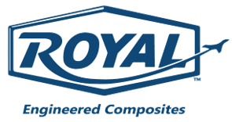

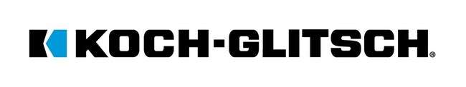


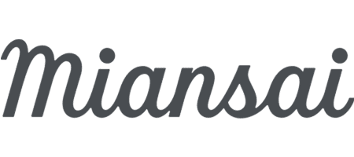

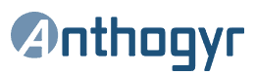
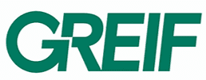
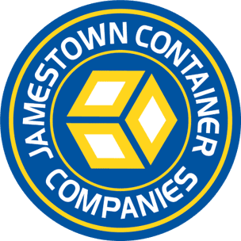



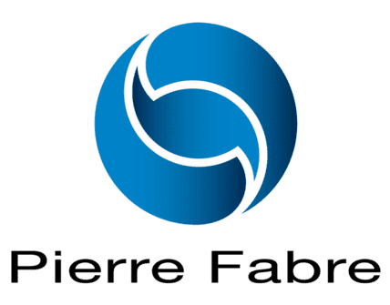
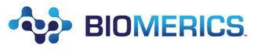

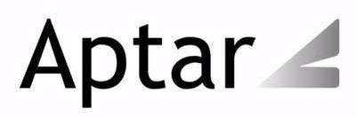




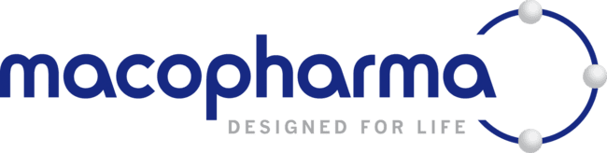


Our Clients
Industrial
Automotive
Aerospace
Electrical/ Electronics
Food & Bev
Consumer
Healthcare
Packaging

Slide 10
SERVICE
Bring service levels up to
as high as 99% or greater
ABOUT US
Winning on the metrics that matter most
SPEED
INVENTORY
Compress lead times
by up to 80%
Reduce inventory
by up to 45%
SIMPLICITY
CAPITAL
Easy and intuitive
Focus on priorities instead of conflicting message
Unleash working capital
Optimize inventory and
operational efficiency
STABILIZE
Reduce variability
Improve due date performance
and stabilize schedules

Slide 11
ABOUT US
The success formula
AI/ML + Demand-Driven Methods
AGILITY MADE INTUITIVE

Slide 12
ABOUT US
How is DDMRP different?
PLANT
PLANT
LOGISTICS
PLANNING
LOGISTICS
PLANNING
SUPPLIERS
SUPPLIERS
FORECAST DRIVEN PLANNING
Current MRP systems use a forecast driven model.
CONSUMPTION DRIVEN PLANNING
DDMRP improves demand signal accuracy by shifting to a consumption driven model.
+ Planned orders create supply orders in anticipation of need.
+ Forecast error associated with planned orders results in inventory misalignments and higher expediting expenses.
+ Only actual demand
within a relevant range impact the planning equation.
+ True consumption gives a near perfect demand signal — what will be sold and when.

Slide 13
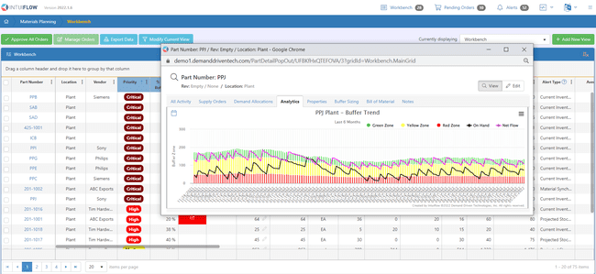
ABOUT US
Buffers analyze how supply is addressing net flow:
Green Zone sized to support average order size or minimum order quantity
Yellow Zone sized to cover usage over lead time
Red Zone sized to address item variation

Slide 14
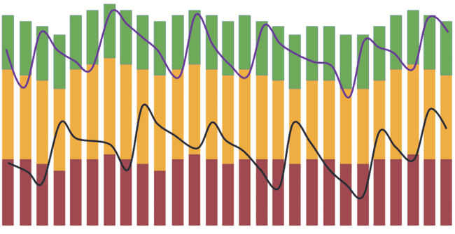
ABOUT US
Net flow
Net flow equation
On-hand inventory
+ Open supply
– Sales orders due today
– Qualified spikes
= Net flow
Inventory level
*Qualified spikes are sales orders due in the near future that are large enough to significantly impact the inventory position
NET FLOW PRIORITY AT THE END OF EACH DAY
Too High
Adequate
Medium
Low or critically low

Slide 15
The 5 components of DDMRP
Position
Protect
Protect
Pull
Pull
Strategic Decoupling
Buffer Profiles
and Levels
Dynamic Adjustments
Demand-Driven Planning
Visible and Collaborative Execution

Slide 16
The Demand-Driven Adaptive Model
Sales & Operations Planning
Tactical and strategic ranges
Automatically adapt to market changes
Model configuration
Performance analysis and future model projection
Demand Driven Operating Model
Materials Planning
Operational range
Optimize your material flow
Scheduling & Execution
Operational range
Get end-to-end visibility
ACTUAL DEMAND

Slide 17

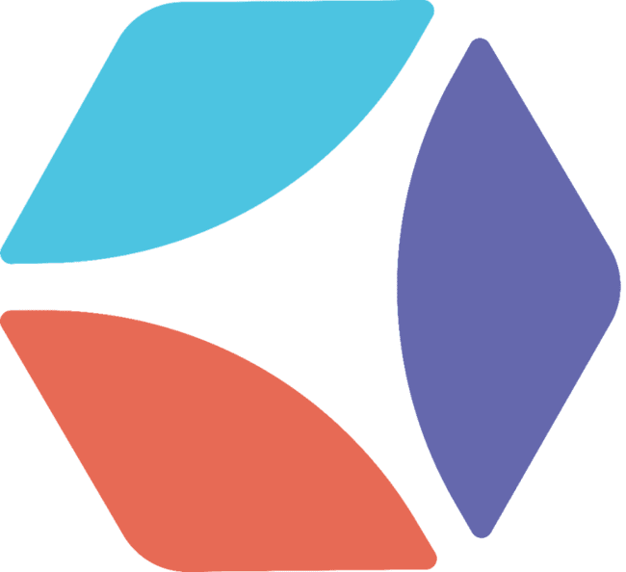
OUR VISION
Intuiflow - Inspired by Innovation
Planning with Intuiflow is like flying in SpaceX Dragon capsule
  Demand Driven Methods
  Automated
  User Friendly
  AI/ML Enabled

Slide 18
PRODUCT FEATURES
MATERIALS PLANNING
SCHEDULING & EXECUTION
SALES & OPERATIONS PLANNING
Improve materials planning by shifting from a forecast-driven to a sales-driven planning approach.
Align replenishment to true market demand
Enhance service levels
Free up working capital
Optimize inventory
Shorten lead times
Improve due date performance on production orders through market-driven prioritization:
Model
Schedule
Execute
Continuous improvement
Increase productivity
Model and synchronize resources
Improve operational stability
Gain insight into backlogs
Gain deep insights into expected demand and impact on materials management and production scheduling.
Enhance service levels
Reduce inventory
Improve operational stability/productivity
Make proactive changes based on expected demand

Slide 19
PRODUCT FEATURES
MATERIALS
PLANNING
SALES & OPERATIONS
PLANNING
SCHEDULING & EXECUTION
Planning workbench
Execution alerts
Easy reorder
Smart buffer profiler
Buffer profile editor
Easy import/export
Report builder
Stock deployment
Part analytics
Planned adjustments
Material availability check
Supply projections
Sales order planning
DDOM monitoring
Promotion report (seasonal demand)
Inventory projector
Buffer trends projector
Rough cut capacity planning
Resource scheduling
Resource modeling
Constraint management
Buffer boards (work order visibility)
Easy work order management
System and resource load insight
Routing visibility
Schedule resources by shift
Key metric reporting

Slide 20
AI/ML
A BETTER WAY TO BUFFER
AI improves the assignment of materials to buffers through enhanced pattern detection that:
SMARTER SUPPLY CHAIN ALIGNMENT
AI/ML improves the performance of Demand Driven Operative Models by powering:
Automatically groups items with similar attributes and behavior
Supports a wider range of lead times
More effectively manages items with variable lead times
Detects changes over time more quickly and accurately
What’s more, the techniques deliver measurable results to performance in the form of service levels, inventory, and working capital.
More comprehensive analysis of changing market dynamics
More accurate alignment of materials to market demand
Faster and more actionable insights about new threats and opportunities
Through these advanced techniques, organizations can achieve more dynamic resource optimization, build more agile production and scheduling capabilities, and realize faster time- to-value on all their supply chain initiatives.
Demand Driven methods meet AI/ML

Slide 21
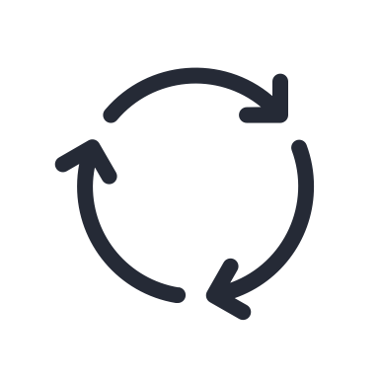




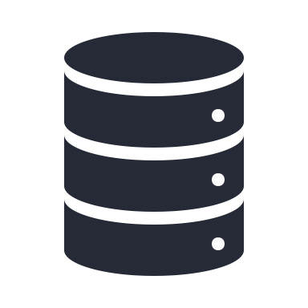

Our Technology
Scalable
Secure
Cloud-based SaaS model
Easy to integrate and deploy
Proven
Hosted on Azure
Translated into 15 languages

Slide 22

ABOUT US
Successful integrations with:

Slide 23
ABOUT US
Our approach to
data factory
Powerful.
More than 90 built-in connectors.
Efficient.
A single solution that saves time and expense.
Secure.
Certified by HIPAA and HITECH, ISO/IEC 27001, ISO/IEC 27018, and CSA STAR.

Slide 24
OUR APPROACH
A six-step process proven to deliver results
01
PROJECT
PLANNING
02
DDMRP
WORKSHOPPING
03
EDUCATION
& TRAINING
04
PRE-LAUNCH
REHEARSAL
05
GO LIVE
06
FINE TUNING
With custom milestones, metrics and KPIs aligned to your goals
To map your
current physical
and transactional material flow
Knowledge transfer on DDMRP principles and applications
for effective change management
Full dry run,
including data validation, interface testing, MRP runs, and system settings
Launch support,
with additional training and monitoring for smooth go-live
Auditing to map progress against KPIs and recommend enhancements

Slide 25
PARTNERS
Why partner with us?
We collaborate with innovators and thought leaders to design, deploy and support solutions tailored to specific needs, objectives and markets.
Work with a leader in Demand-Driven MRP
Generate new revenue
Expand your value proposition to drive better results for your clients
Offer a cutting-edge planning and execution tool
  Take advantage of synergies with complementary solutions in warehouse management, logistics and other supply chain technologies

Slide 26


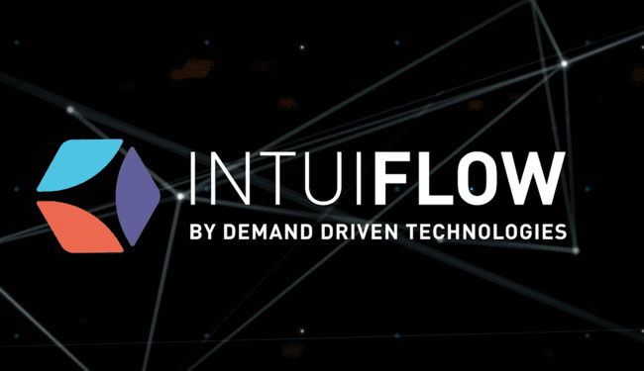


OUR MISSION
Welcome to the future of Supply Chain Planning
  Increasing agility and resilience across the most complex operations
  Bringing to life a greener and more effectively planned supply chain
  Bringing a responsible, friendly and collaborative approach for your teams

Slide 27
+1 888 817 7822
info@demanddriventech.com
400 Northridge Road, Suite 590, Atlanta GA 30350

